Slide 1
Introduction to Computers and Programming
Colorado State University
Computer Science Department
Slides Originally Created by Albert Lionelle (Albert.Lionelle@colostate.edu)

Slide 2
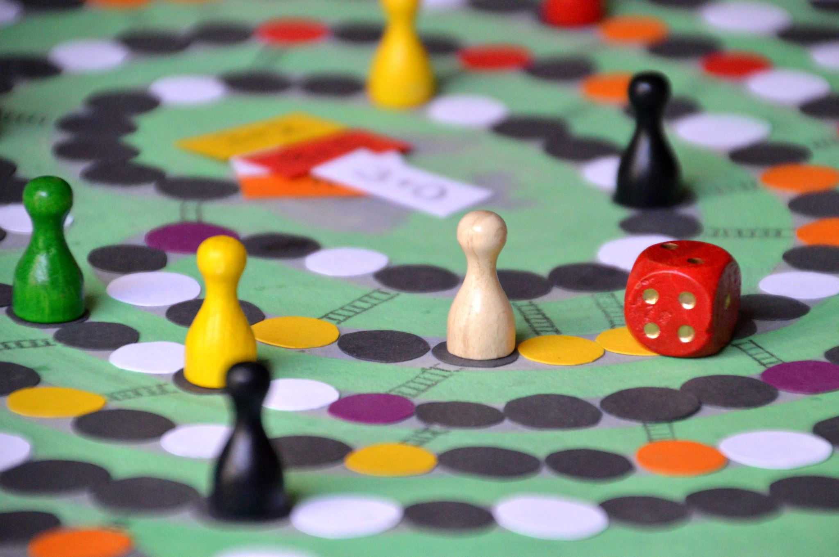
Weekly Announcements!
TODO Reminders:
Setup MS Teams
Reading 1 (Zybooks)
Syllabus Quiz
Knowledge Check
Will have these up every week!
Start of every class as you come to class.
Friday Lecture – catch up and zybooks help! (optional)
ACM / ACM-W - Welcome Back Boardgames!
Pinon Hall 131 (the study area)
Thursday (26th) 6:00 PM
A super popular event, great way to meet others in the major, and have fun!

Slide 3
Industries For Computing?
5 Min
Break into groups
Brainstorm industries in which computers are used in
How many require specialized applications?
Saying all is not a valid answer (for this)! – you must have an actual use before listing the industry
Go to a white board, and write down all the options you came up with!
Circle the one you think was the “first industry”
Deeper discussion:
Why are computers involved in so many?
What do they accomplish that humans can’t/don’t?

Slide 4
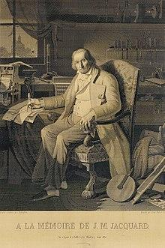
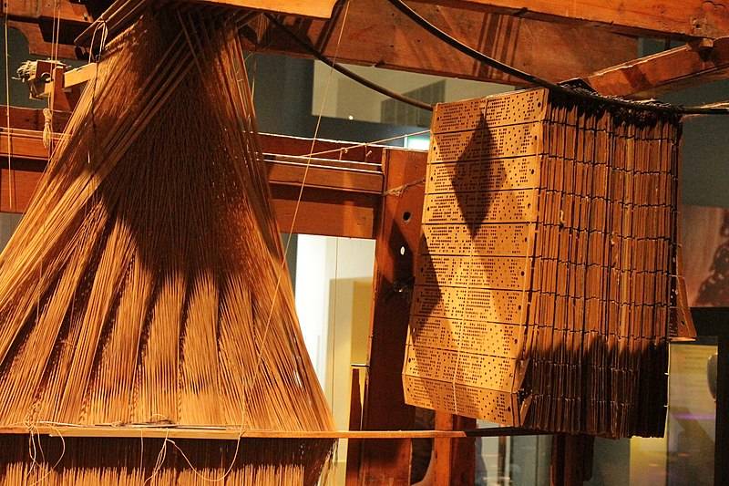
First Computer?
The industry - Weaving!
Jacquard loom / machine
Invented by Joseph Marie Jacquard in 1804
Cards set the patterns, colors, etc
Very specific use - not general purpose
Charles Babbage – First general purpose machine
Ada Lovelace – First programmer of the general purpose machine
We have come a long way over the years!!
A Jacquard– ref: https://en.wikipedia.org/wiki/File:A_Jacquard_loom_showing_information_punchcards,_National_Museum_of_Scotland.jpg
“This portrait of Jacquard was woven in silk on a Jacquard loom and required 24,000 punched cards to create (1839). “ - ref: https://en.wikipedia.org/wiki/Jacquard_loom

Slide 5
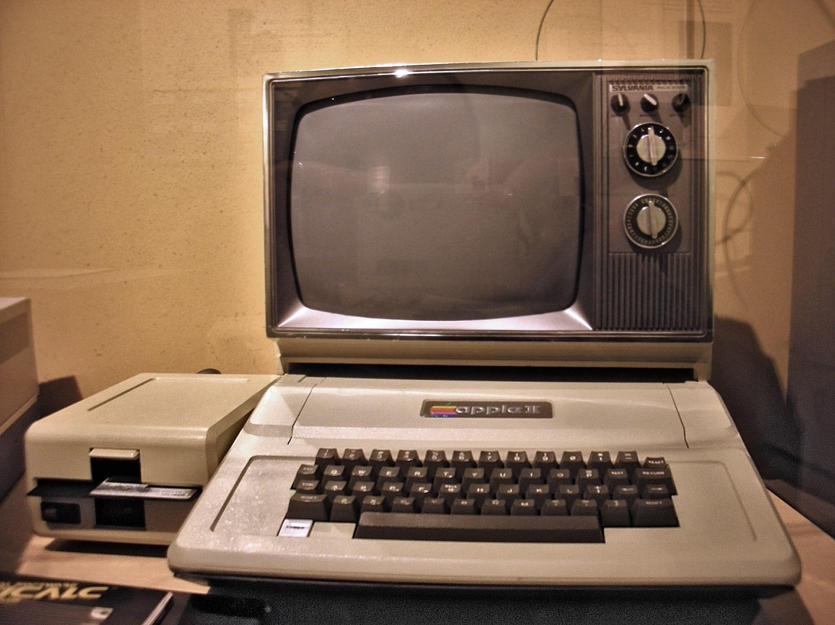
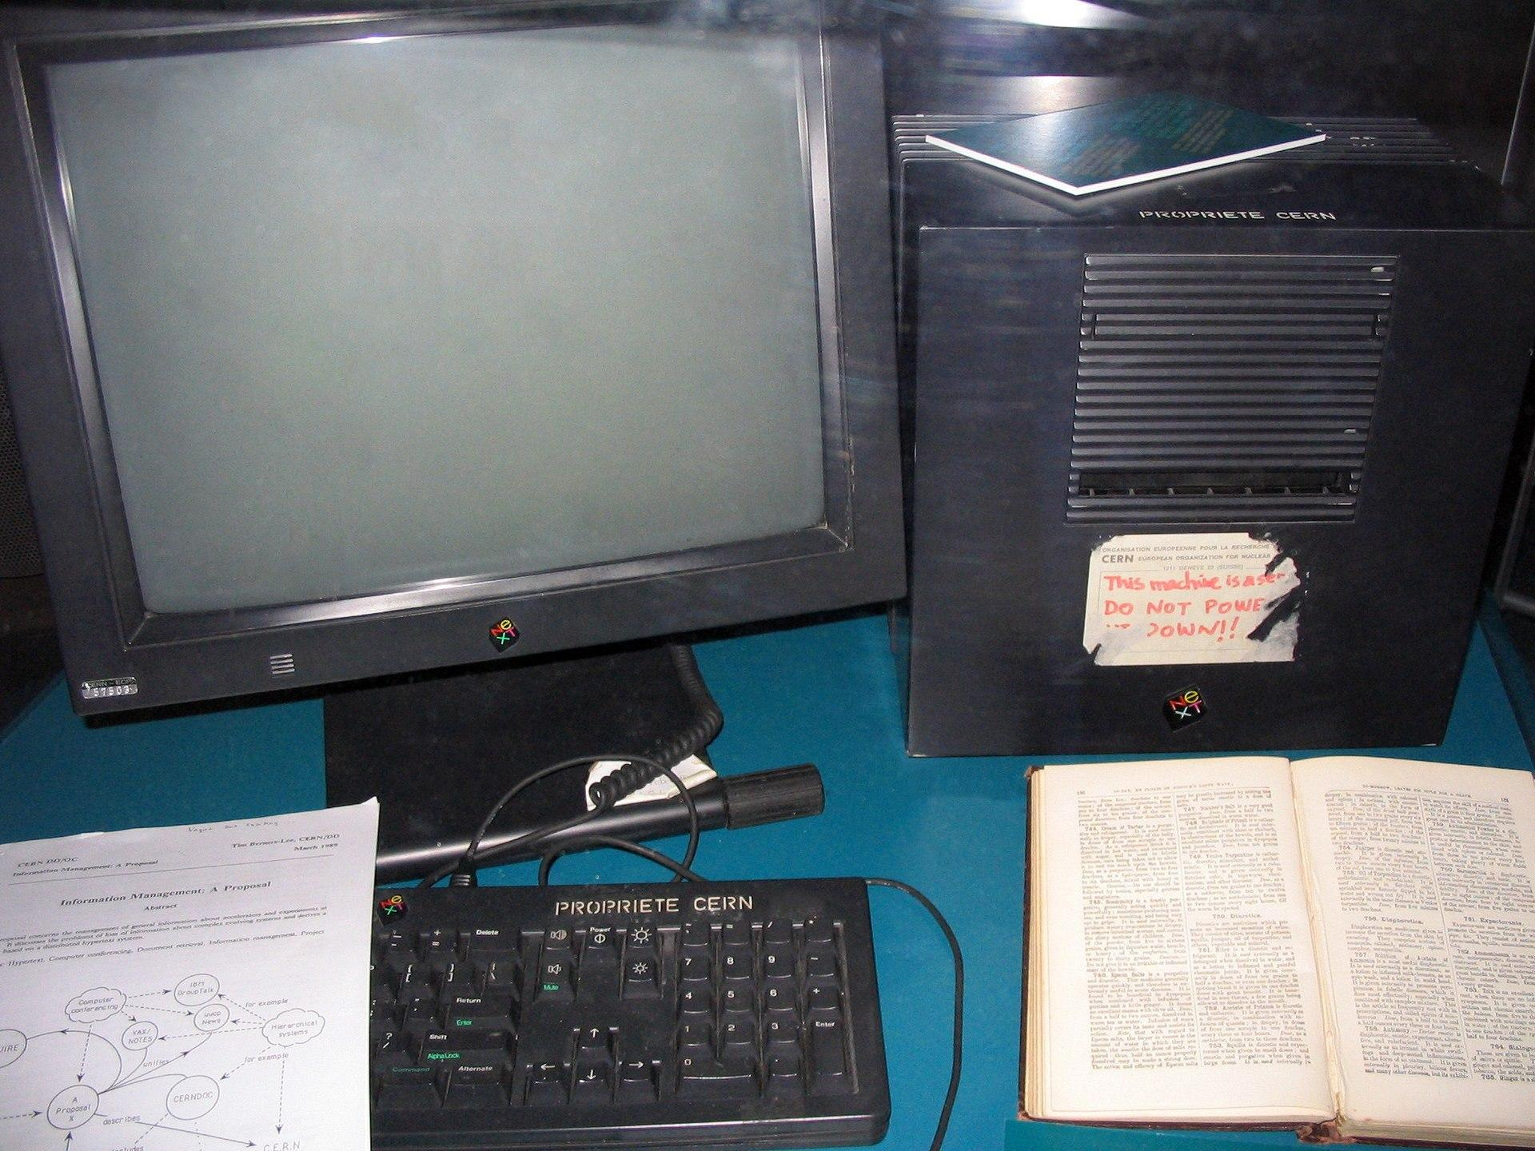
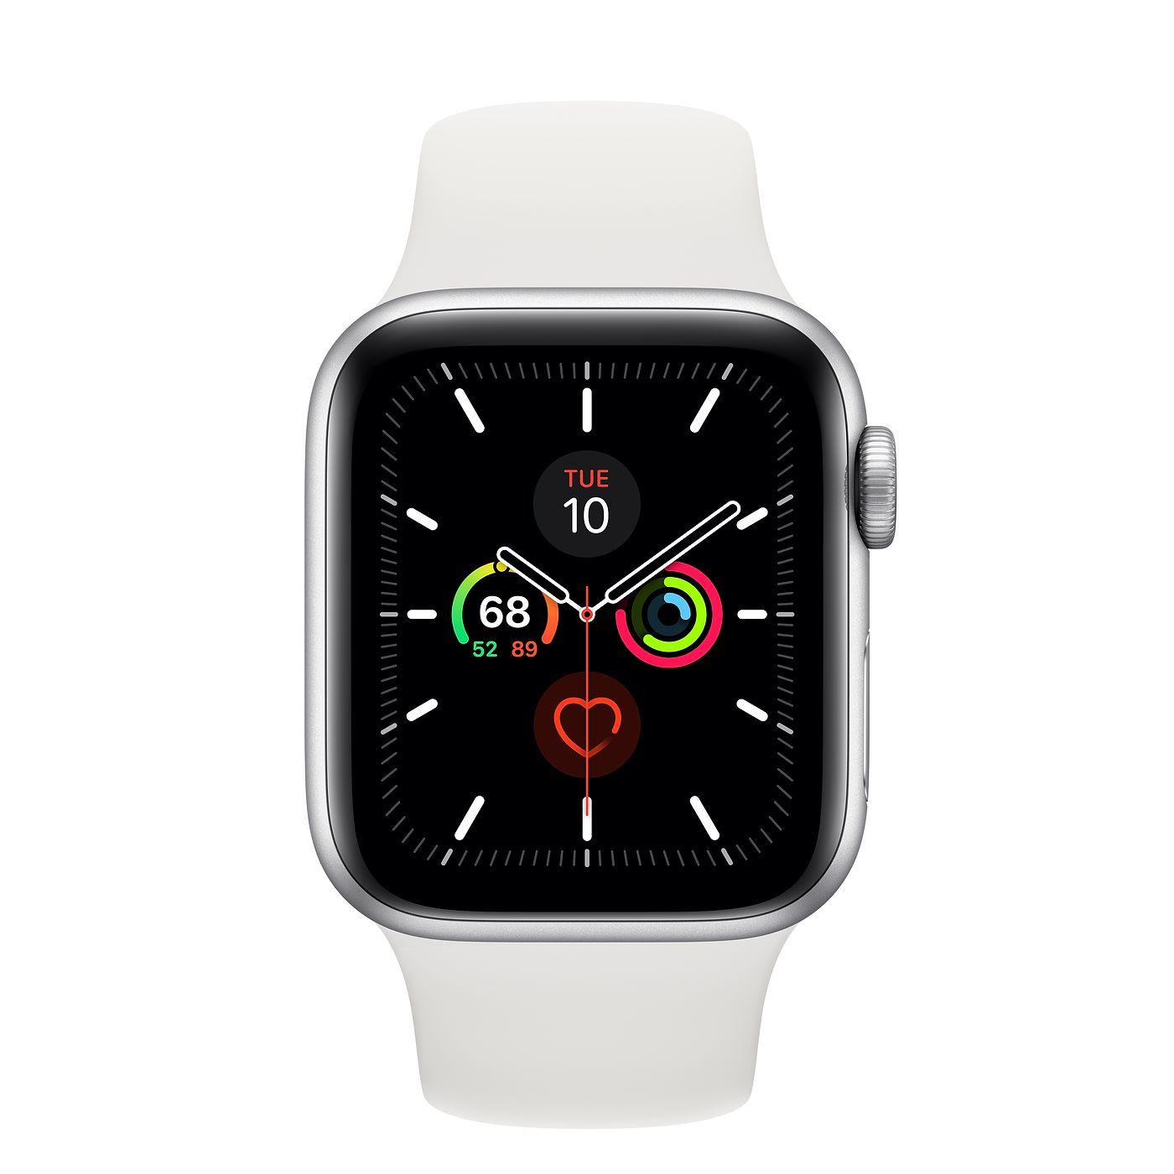
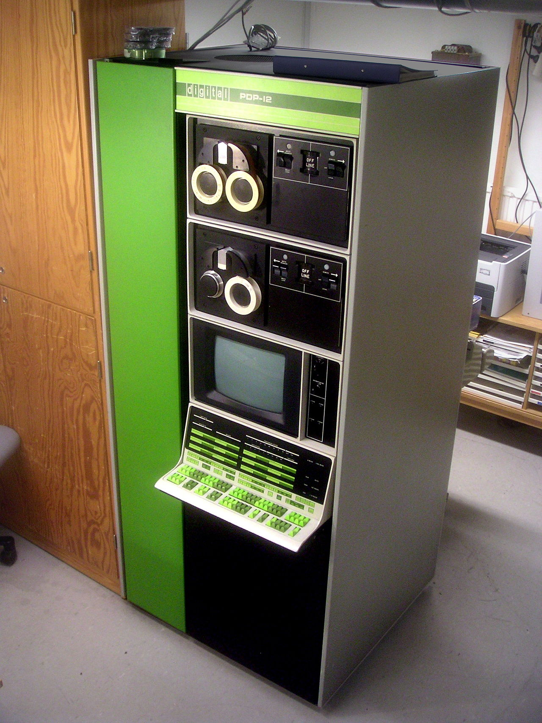
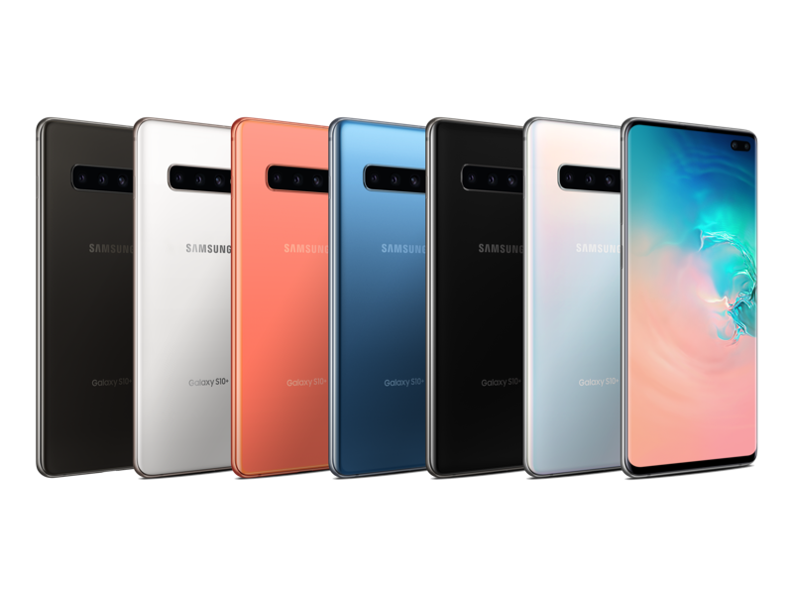
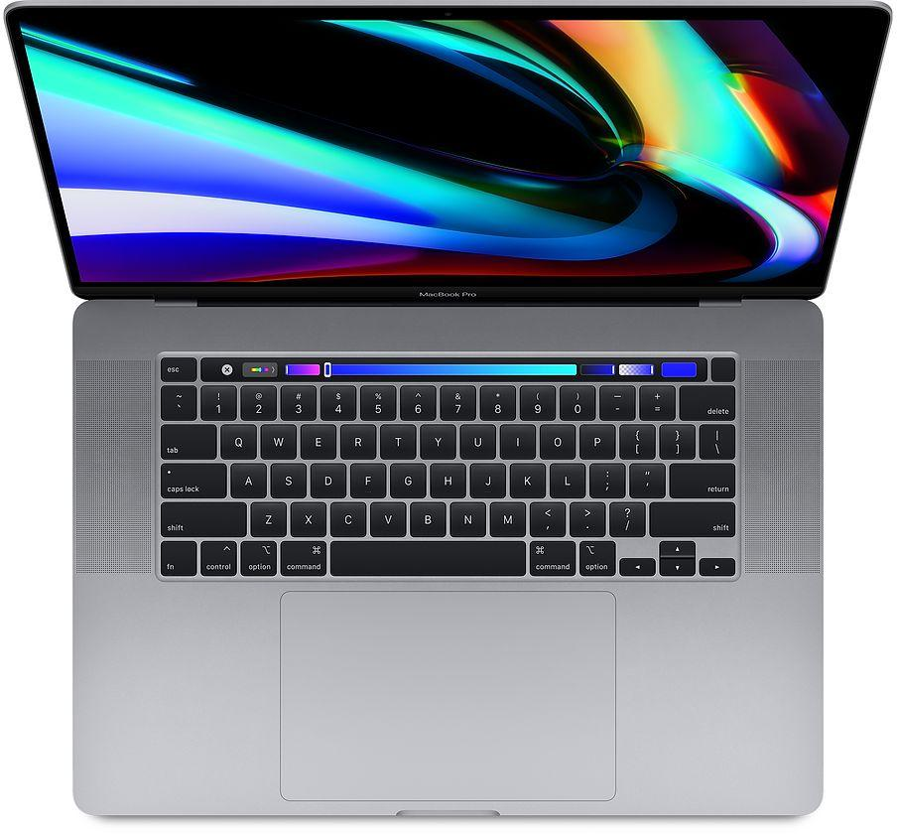
Computers
Come a long way!
Part of our everyday life
Phones, Watches, Laptops, more
None of it works without people!
Technology is a human activity
Computers work in concert with humanity, not seperate.
Think of a violin
Does it create music by itself?

Slide 6
Computers Hold STATE
Think of water states
Liquid, Ice, Gas - it is said to have multiple states.
Memory has two states (binary)
On and Off
Yes and No
true and false
1 and 0
This is stored in a BIT
All the representational power of the computer
A bunch of bits
Representing various states!

Slide 7
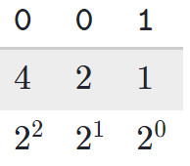
Bits and Numbers
We assign values based on location
Every location can have 2 values (0 or 1)
First spot - even or odd
Second spot - 2
Third spot - 4
3 bits can represent 8 different things (0-7)
0
1
0
1
0
1
0
1
0
= 0
0
= 1
1
= 2
1
= 3
1
= 4
1
= 5
1
= 6
1
= 7
0
0
0
0
0
0
1
1

Slide 8
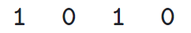
Bits and Numbers
If we have 4 bits, how many different things can we represent?
And with 8?
8 bits = 1 byte, basic unit of information
Would be painful to write it out / set it
All the time!
We want to write english words
Thus the power of programming
Note: Throughout Semester - we will write things in memory - but more of the style below
2
6
7

Slide 9
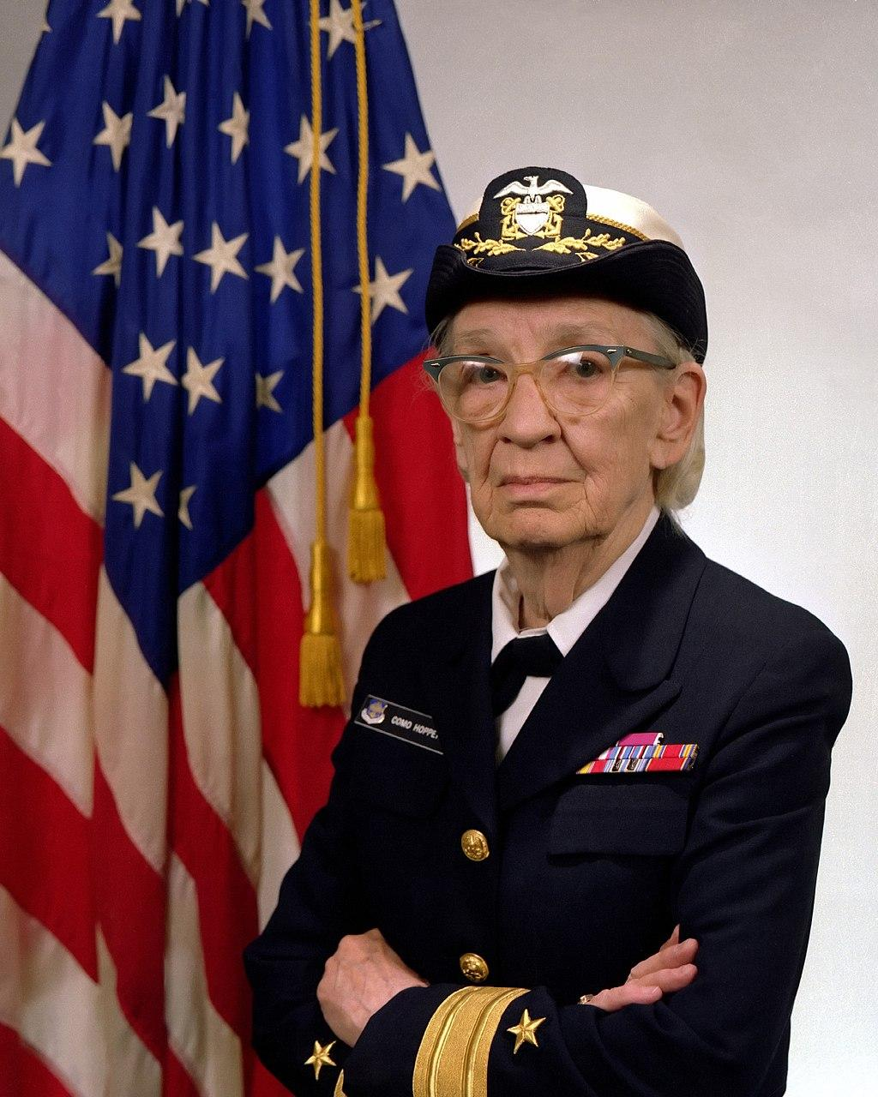
Coding
Coding used to be literally moving physical wires
And was unique to every machine
Then code became compiled
From English to 1s and 0s!
Who do we have to thank for compiled code?
Admiral Grace Murray Hopper
Designed the COBOL language
Her dream? Write once, run everywhere!
But it took many years for it to come to pass..
By James S. Davis [Public domain], via Wikimedia Commons. Source

Slide 10
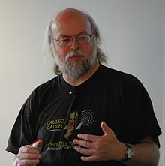
Java Bytecode
Hello.java
public class Hello {
public static void printHello() {
System.out.println(“Hello World”);
}
public static void main(String args[]) {
printHello();
}
}
Write once - run most anywhere
James Gosling lead designer
Fun Fact
Android is the most used operating system in the world
Written in Java
Programs are a set of instructions
Written in English - very specific instructions
javac - compiler
0001100001010101010101010101001010101010101010100101010101010101010101010100101010101010101010100101010101010101010101010010101010101001001010001
Hello.class
James Gosling lead designer for the javac compiler
CC BY-SA 4.0 by Peter Campbell

Slide 11
Coding is a set of instructions
5 Min
As a group, write instructions for:
Making a PB&J Sandwich!
Let’s see what we get
Moral of the story – Include every step, computers don’t have context!

Slide 12
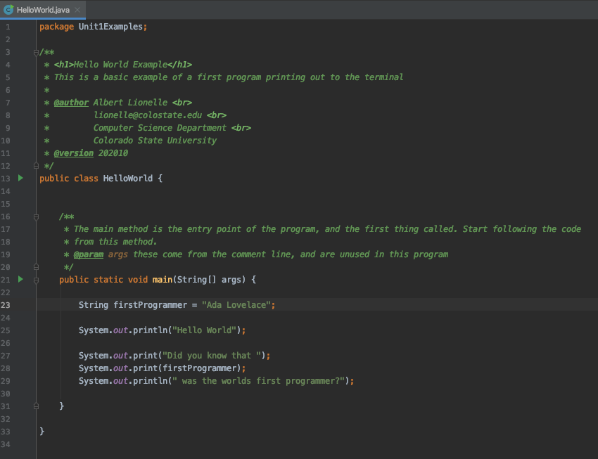
Program is a set of instructions
This is a comment
In java, instruction sets are written in class blocks
Method! - let’s look closer
Pro Tip: All examples in this class are available on github for you to download.

Slide 13
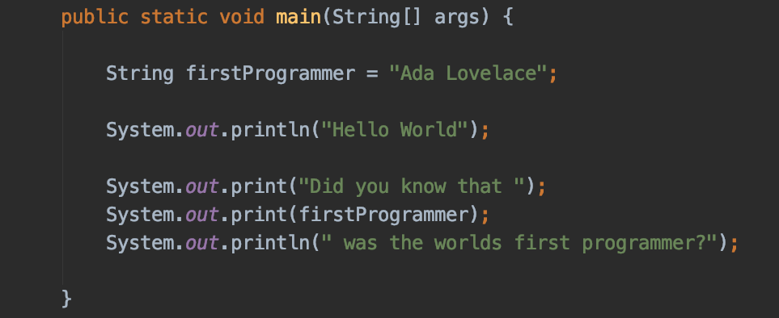

Method
Setting “Ada Lovelace” to the variable firstProgrammer
Printing out to the console/terminal

Slide 14
Live Code Example
Will use Zybooks – for today, so you can see!

